Slide 1
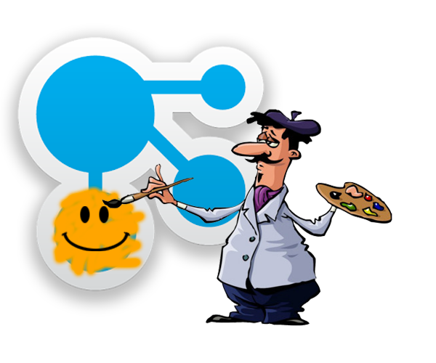
What you need to know about Connections Customizer
Scott Good
North American Above-Market Technical Sales

Slide 2
Today’s agenda…
?
A mercifully quick (but understandable) overview of Customizer
Demo! Demo! Demo!
Three examples of highly-modified Connections environments using Customizer (that you can use, too)
Details
What’s the difference between Customizer and ICEC?
Usage
How do you set it up?
How do you make changes?
Limitations
What you can (and can’t) do with Customizer
What you probably shouldn’t do with it

Slide 3
The problem we’re trying to solve…
Outside of ICEC, Connections is hard to modify, for either (or both)…
Different look-and-feel (UI)
Enhanced functionality
And, Connections has a dated interface
Customizer gives us a way to add…
JavaScript
CSS
Images
Other kinds of files…
…to change how Connections looks and works
NOTE: Customizer does not work on ICEC pages (but doesn’t really need to)

Slide 4

What is Customizer?
A new capability in Connections
Based on…
Who the user is
Or what the web page is
(Or combinations of both)
Customizer adds one or more JavaScript files to the page as it is being sent back to your browser
(this is the part that matters)

Slide 5
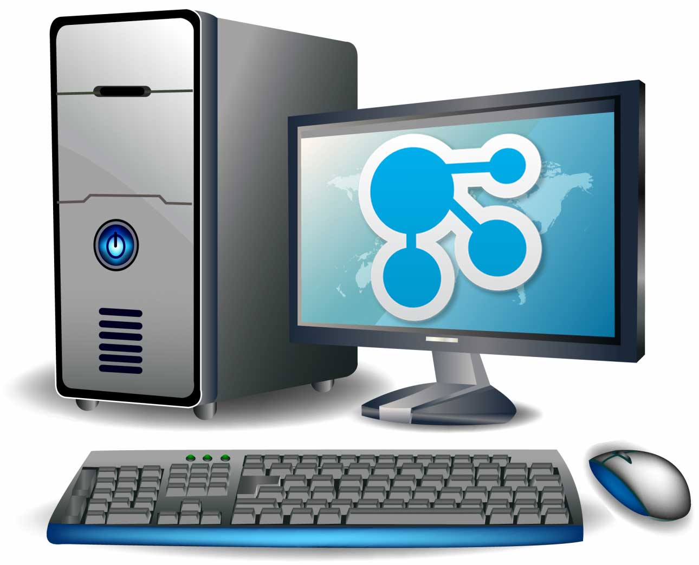

How it works
Diane’s browser requests a Connections page from the server
The server figures out what files are required for that page and sends them back (html, css, javascript, etc)
HTML/CSS/JS
Diane’s browser uses those files to organize, format, and
display all the things she sees
on the web page

Slide 6
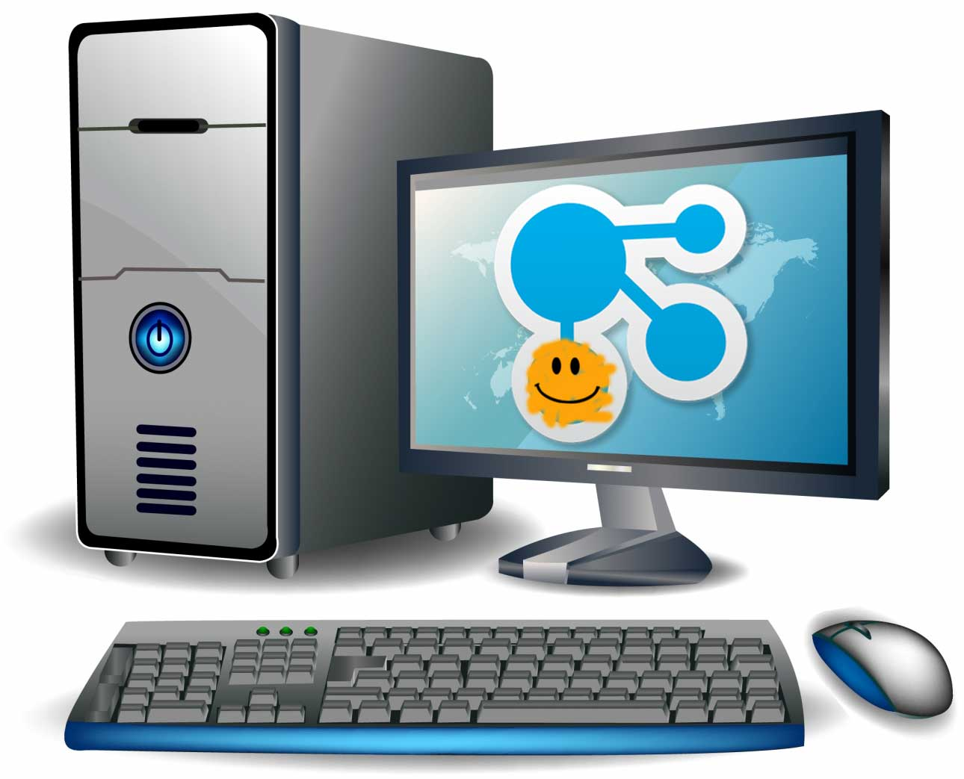
How it works
Diane’s browser requests a Connections page from the server
The server figures out what files are required for that page and sends them back (html, css, javascript, etc)
HTML/CSS/JS
Diane’s browser uses those files to organize, format, and
display all the things she sees
on the web page
The server also says “hey, this is Diane…I have a special rule for her” and sends one or more extra JavaScript files to the browser
JavaScript for Diane
Illustrations courtesy of all-free-download.com

Slide 7

How it works
Diane’s browser requests a Connections page from the server
The server figures out what files are required for that page and sends them back (html, css, javascript, etc)
HTML/CSS/JS
This part is Customizer!
The server also says “hey, this is Diane…I have a special rule for him” and sends one or more extra JavaScript files to the browser
Diane’s browser uses those files to organize, format, and
display all the things she sees
on the web page
JavaScript for Diane
Illustrations courtesy of all-free-download.com

Slide 8
That’s all…?
Yes. And…well…no.
The JavaScript added to the page by Customizer can do all kinds of things
Inject CSS files to change the overall look and feel
Modify or hide existing page elements
Add new elements to the page
Retrieve data from elsewhere…even outside Connections for…
Addition of outside content
Personalization information/instructions
Whatever else you can dream up
Someday Customizer may be able to make server-side modifications…but not today
Details here: https://www.ibm.com/developerworks/collaboration/library/customizer-intro/index.html

Slide 9
Demos!

Slide 10
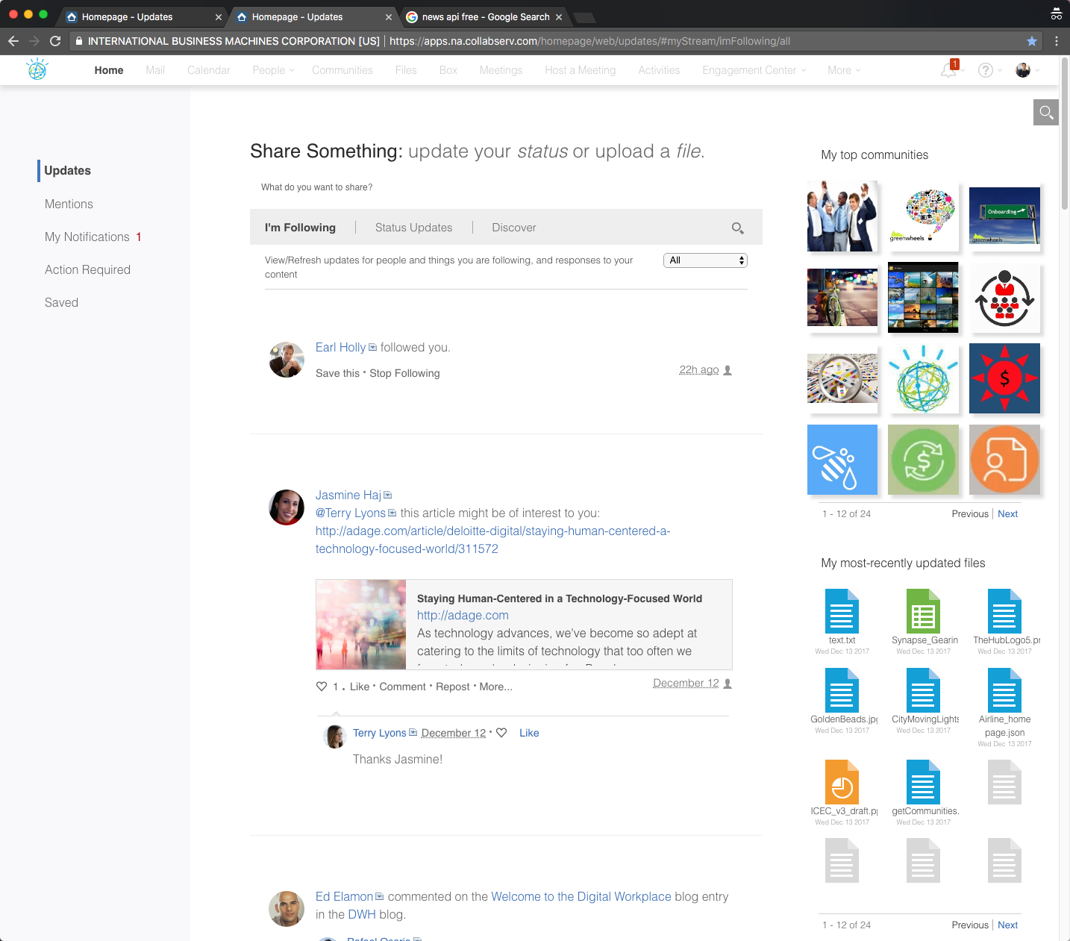
“Apple UI”
john.morrison@llshowcase.com (Sh0wcaseIBM)
Applies to (mostly) all pages
Not Meetings, Calendar, Mail, or Admin
Menu bar lightened
Watson logo inserted
User photo hidden
Fonts changed & enlarged
White space added throughout
Meetings & Events hidden
Communities & Files added

Slide 11
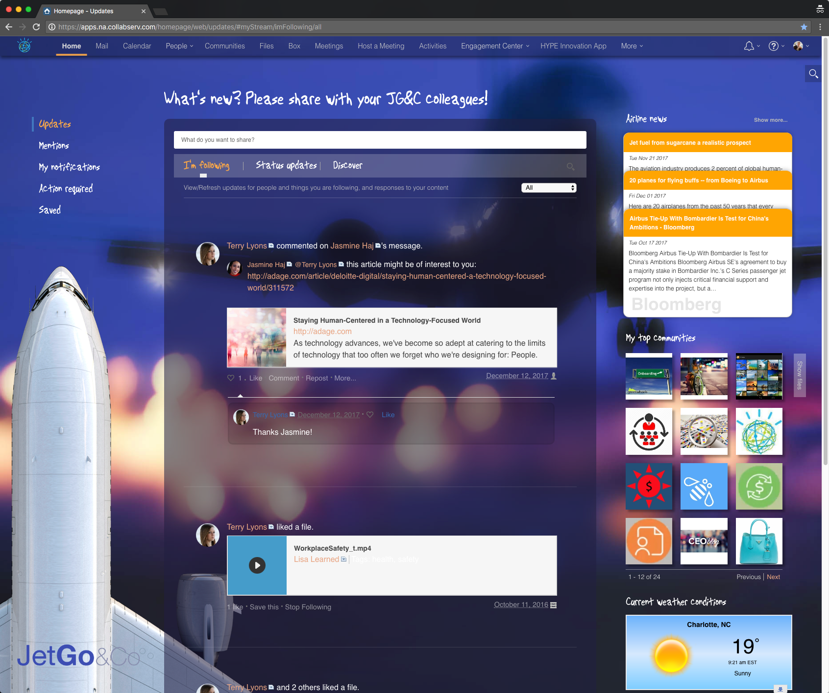
“Airplane UI”
earl.holly@llshowcase.com (Sh0wcaseIBM)
Applies to homepage only
All of Apple UI changes
New color theme, background image, animated background (the jet)
Text labels replaced with images (to get script look)
Logo added bottom left
Communities/files flipper
Airline news is a live external query
Outside widgets were added
Weather, stock prices
Uses cookies
To remember airline stock selected

Slide 12
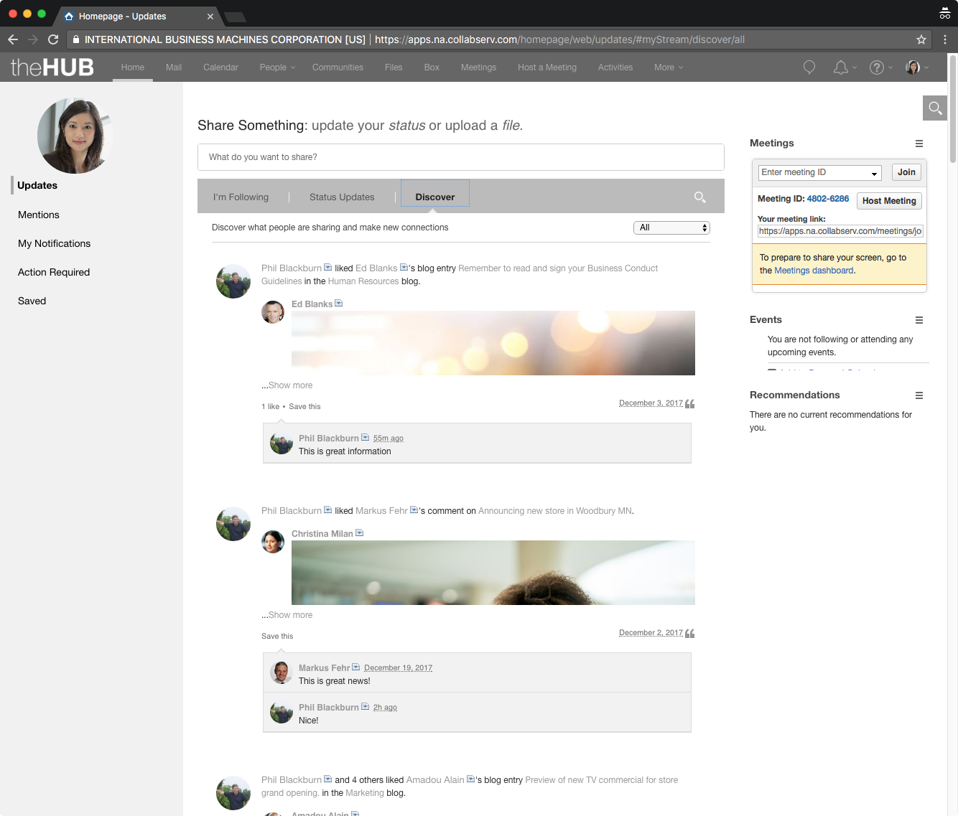
“ICEC UI”
andrea.ellison@llshowcase.com (Sh0wcaseIBM)
Uses Customizer to match the look-and-feel of Connections to the modified ICEC UI
Changes colors and fonts
Retains much of the Connections layout (but that could be changed, too)
Cannot change some pages
Mail
Calendar
Meetings
Box
BUT, it improves the overall experience when users exit ICEC and enter communities, retrieve files, or create activities

Slide 13
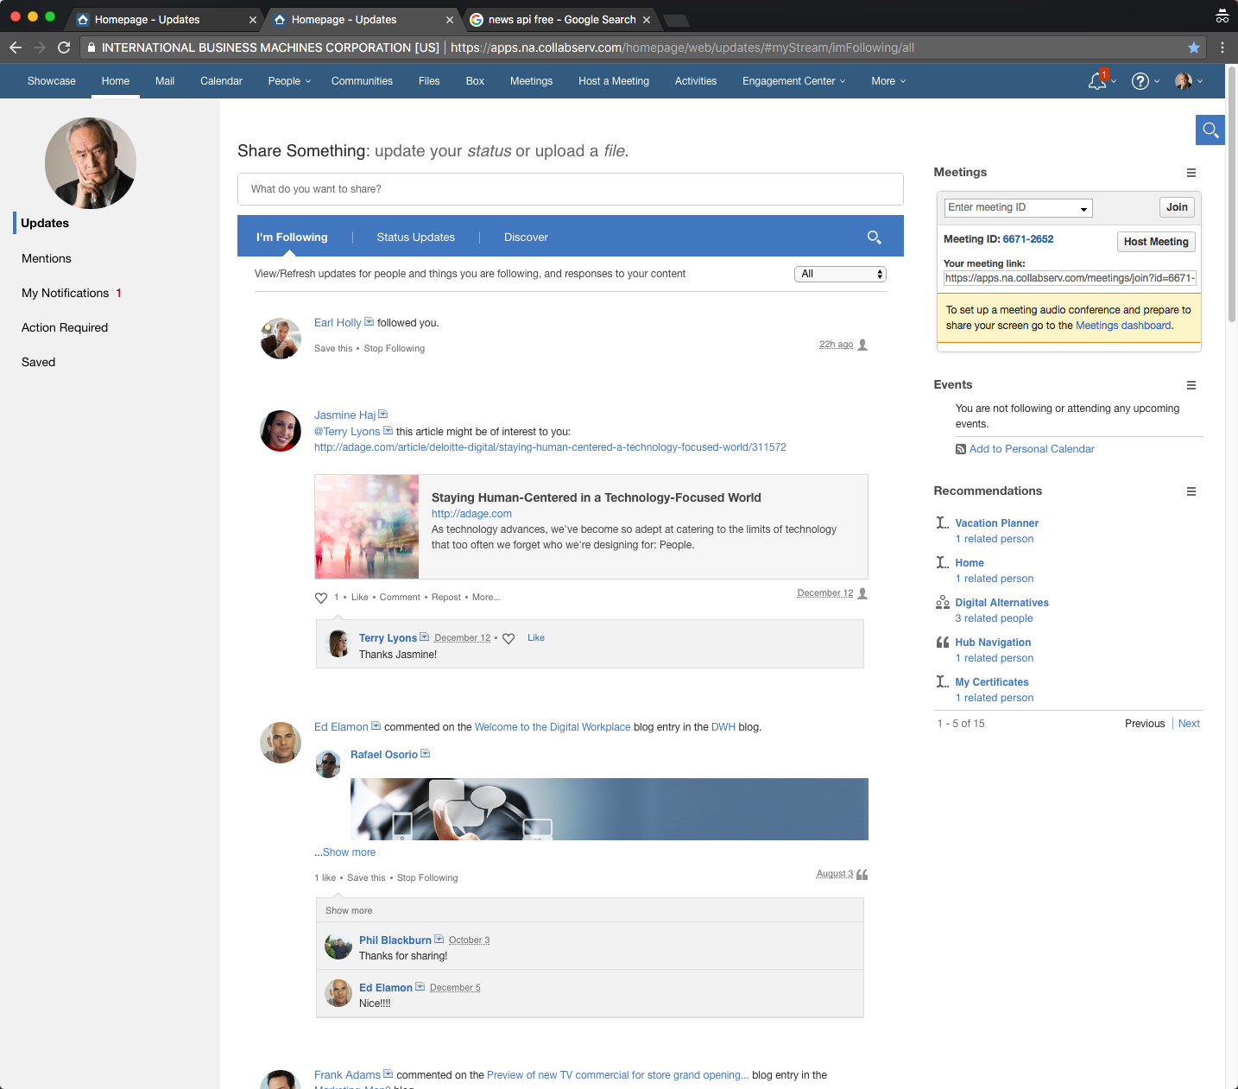
Test users you can demo with…
mark.fisher@llshowcase.com (Sh0wcaseIBM)
Sees the normal Connections UI
john.morrison@llshowcase.com (Sh0wcaseIBM)
Sees the “Apple” UI on all pages
earl.holly@llshowcase.com (Sh0wcaseIBM)
Sees Airplane UI on homepage
andrea.ellison@llshowcase.com (Sh0wcaseIBM)
ICEC/Connections matching UIs

Slide 14

Various points…
JavaScript files used by outside widgets (e.g., weather) need to be uploaded to the page
Not just referenced (due to cross-site scripting limitations)
Code you add to the page can also call JavaScript functions from your JS library
Browser cookies can be set and read
For personalization, to remember settings, or for whatever else
CSS cannot be loaded from the Org Extensions
Multiple JavaScript files can be
JavaScript can upload CSS files to the page
iFrames can be added to the page with JavaScript
Some sites (e.g., Google) don’t work in iFrames

Slide 15
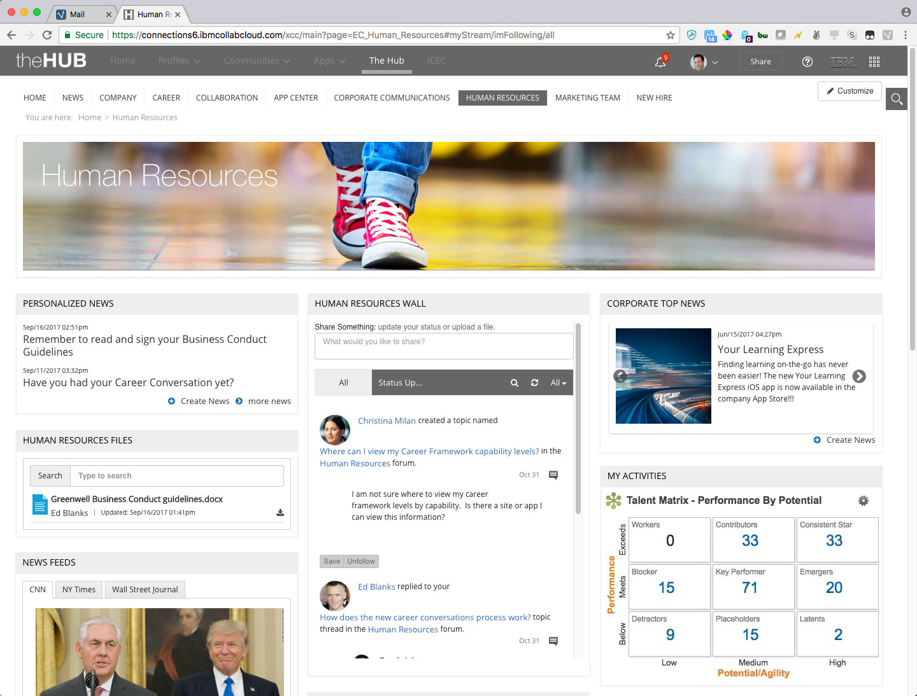
Connections vs ICEC: what’s the difference?
Connections is its own data source, and presents its own content in a standardized UI
ICEC presents content from other sources, including Connections; has no content of its own; easily modified

Slide 16

Customizer vs ICEC: what’s the difference?
Connections Customizer
Cannot change ICEC pages
Also doesn’t work on Meetings, Calendar, Mail, Administration, or mobile app
Modifies standard Connections pages
Change look and feel
Add / remove functionality
Interact with content / systems outside Connections
Enabled by user and/or URL
Different users can have different experiences
Or different areas of the site can vary
Requires developer skills
Not as easy to use as ICEC
Not for the casual user
Requires IBM review to upload new files…?
Is much easier than any other alternative
But still requires a developer
IBM Connections Engagement Center (ICEC)
Cannot change standard Connections pages
Displays content from elsewhere
Can display Connections content but also that from elsewhere
Many existing widgets and page layouts to choose from…and you can make more
Separate mobile UI from Connections phone app
Easily customizable UI
Some can be done by non-developers
Upload and use your own CSS and images for themes
Custom JavaScript can be added, too
End-user customization of pages is quite possible
“Open in Community” links take you right into unmodified Connections
Can be confusing to users
Allows some personalization of content
Has its own mobile browser interface

Slide 17

Setup and usage
1
Your code (CSS, JS, etc) is written locally but tested from the server
Tampermonkey or GreaseMonkey can be used (up to a point) to build locally
Code is uploaded to GitHub
Code is transferred from GitHub to the server
Either automatically or via pull request
Server then sends the specified files to users
As defined in Organization Extensions
Transferred files (JavaScript) are handled by the browser
2
Code transfers from GitHub to the Connections server
3
Write code, then upload it to GitHub
4
5
After transfer, refresh browser to see changes

Slide 18
What you can and can’t do with Customizer
Can
Can add new functionality; hide or alter existing
Can add new elements to the page
Can access outside content (via AJAX, etc.)
Can retrieve Connections content (e.g., my Communities, my Files)
Can access browser data (cookies, localStorage, sessionStorage)
Can add CSS stylesheets to the page to change look, feel, and/or behavior of page elements
Add multiple JS libraries from Org Extensions settings
Cannot
Doesn’t work in the Connections mobile app
Doesn’t work on Meetings, Mail, Calendar, or Admin pages
Doesn’t work in ICEC

Slide 19
Questions?

Slide 20
Thank you!
Scott Good
NA Above-Market Technical Sales
scott.good@us.ibm.com

